Slide 1









CLSDirect Project Team
CLSDirect
One connected team, working closely across every discipline.
S
Project Lead
Shyam
G
Server-Side
C
UI
M
P
Garima · Lead
Chirag · Lead
UX Designer
Scrum Master
IDP & Java SME — Yan
POC work — Binod
Madhav
Preethi
Release & Change — Hussain
AutoQA — Rufin
Java Devs — Ankur & Shubham
UI Devs — Rohan* & Pallavi
COLLABORATES WITH
Ar
An
Ra
Ab
Data Team
BA Team
Product
PM Team
QA
Architecture
David, Mustafa, Ujjwal
Ismaeel, Sudip
Aravind
Ankur
Rajnikanth · Lead
Abhijit
Rohini, Vandana, Chaya, Neha, Anjali, Medha, Shivraj
*Rohan also leads the offshore pod.
Notes:
CLSDirect project team, one slide, emphasizing collaboration over hierarchy. Every box leads with the team or responsibility, then the person: Project Lead (Shyam); Server-Side (Garima, lead) with IDP & Java SME (Yan), Release & Change (Hussain), Java Devs (Ankur & Shubham); UI (Chirag, lead) with POC work (Binod), AutoQA (Rufin), UI Devs (Rohan & Pallavi, Rohan also leads that offshore pod); UX Designer (Madhav); Scrum Master (Preethi). Below the dashed "collaborates with" line, teams that work with this group but do not report to Shyam: Data Team (David, Mustafa, Ujjwal), BA Team (Ismaeel, Sudip), Product (Aravind), PM Team (Ankur, a different person from the Ankur on server-side), QA (Rajnikanth, lead) with offshore QA engineers Rohini, Vandana, Chaya, Neha, Anjali, Medha and Shivraj, and Architecture (Abhijit).

Slide 2

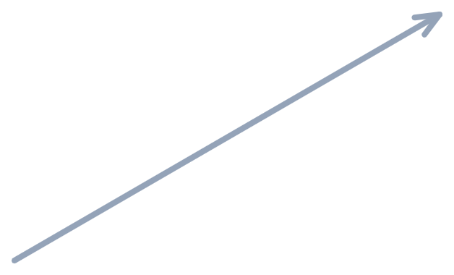
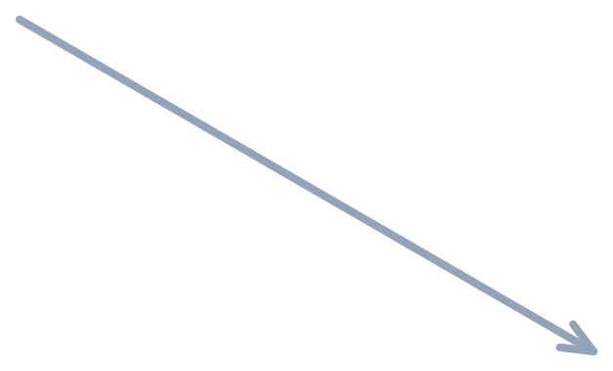





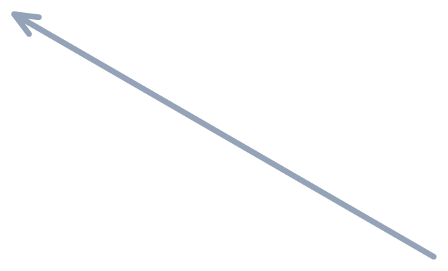



CLS Hybrid Agile 1.0
CLSDirect
How the team runs every sprint — six ceremonies, one continuous loop.
Sprint Planning
NEW
Story Sizing
Daily Scrum
Sprint Cycle
repeats every sprint
Backlog Grooming
Demo & Feedback
Release Retrospective
Agile Poker was introduced this year for story sizing — and it's already proving effective.
Notes:
CLS Hybrid Agile 1.0 - the six ceremonies the team runs every sprint, shown as a continuous loop around a central "Sprint Cycle" hub: Sprint Planning, Daily Scrum, Demo & Feedback Sessions, Release Retrospective, Backlog Grooming, and Story Sizing & Estimation. A "NEW" badge marks Story Sizing because Agile Poker was introduced this year for that ceremony, called out again in the highlighted banner at the bottom: it has already proven effective for the team.

Slide 3




Process Maturity Journey
CLSDirect
From a formal document to daily practice — and what's next.
TODAY
LAST YEAR
THIS YEAR
NEXT
THEN
Process Formalized
Put Into Practice
Doc Updated to v1.1
Published for Approval
Documented and rolled out.
Training and discipline made it stick.
Estimation process fully described.
Goes to management for sign-off.
Two steps done, two steps ahead — the discipline is already paying off.
Notes:
Process maturity journey for CLS Hybrid Agile. Last year: the process was formalized and documented. This year: it has been effectively put into practice, driven by team training and discipline (including the successful introduction of Agile Poker). A dashed "today" line marks where the team stands now. Next: the process document will be updated to version 1.1, with the estimation process fully described. Then: v1.1 will be published for management approval.

